Slide 1
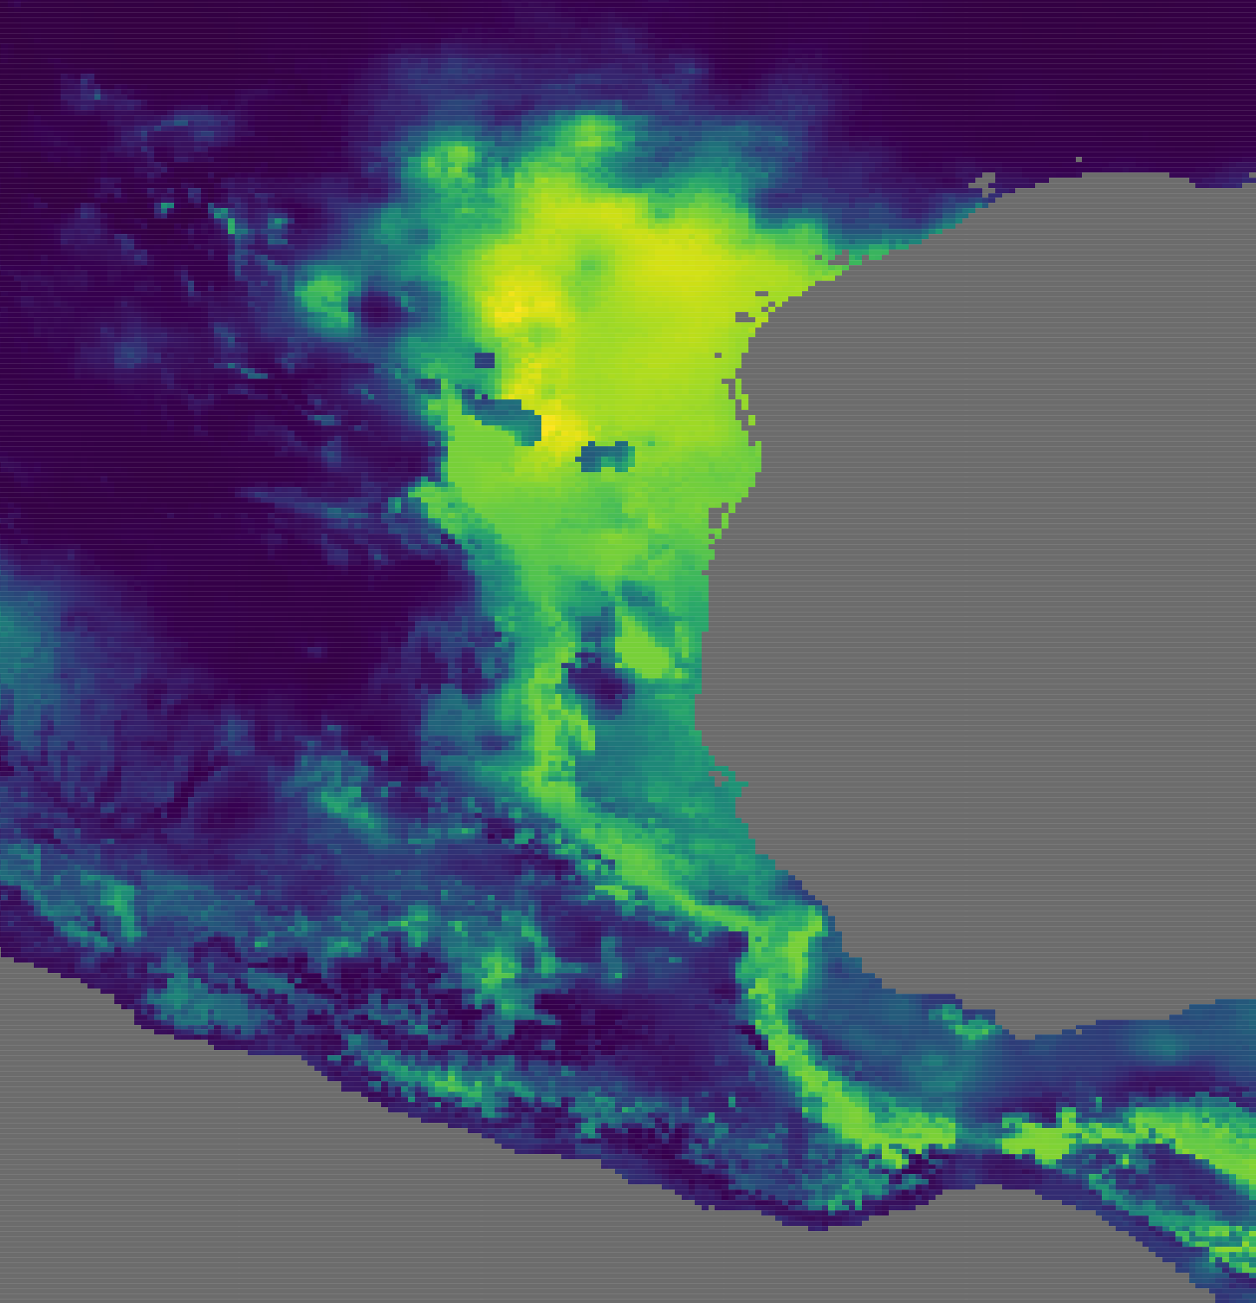
Accessing biodiversity data repositories through R
Adrian A. Castellanos
OSOS 2018 Sept. 1

Slide 2




What are large data repositories?
You probably already use them!

Slide 3
Why use these resources?
Why use anything?
Add samples to your study
Genetic data, phylogenetic trees, occurrence records
Provide context for your research
Species ranges
Decades or centuries of data!

Slide 4
Module Outline
iNaturalist (rinat package)
Query for records of a single species
Query for all records in an iNaturalist project
GBIF (rgbif package)
Query for a single species and an entire family
Query for the entire BRTC mammal collection!
Species richness, observations, phylogenetic diversity

Slide 5
Why use R for this?
Q: “My neighbor just downloads .csv files from GBIF. Why do you have to make things so complicated?”
A: 1) No one likes Excel. 2) Those .csv files are hideous. 3) Your analysis is in R!
Querying through R provides flexibility!

Slide 6
iNaturalist
What: Citizen science documentation program
Who: Really just about anyone (they even have an app available!)
Example: Herps of Texas

Slide 7
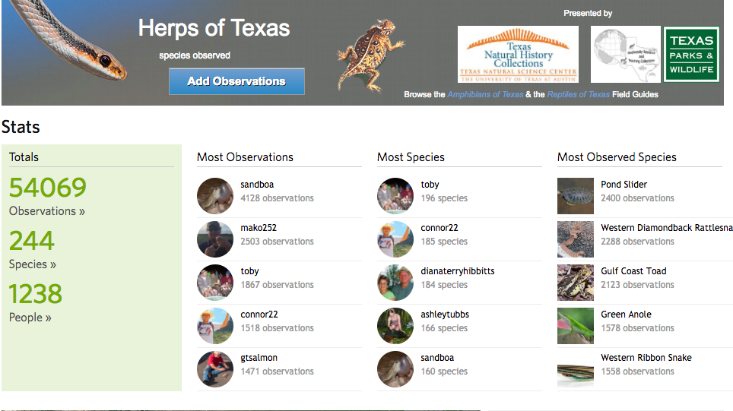

Slide 8
Querying in rinat
3 main ways to query:
Species level
Project level
User level
Can filter your queries by time, location, quality, whether records have coordinates, etc.

Slide 9
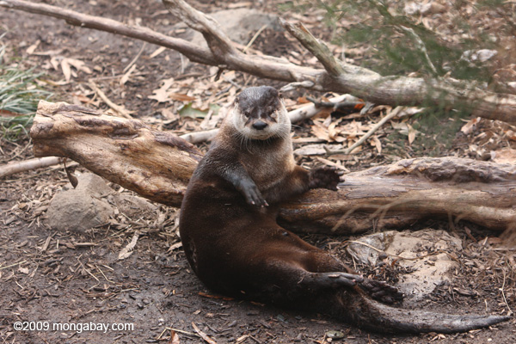
Let’s start!
Open R/RStudio
First example is looking at Lontra canadensis

Slide 10
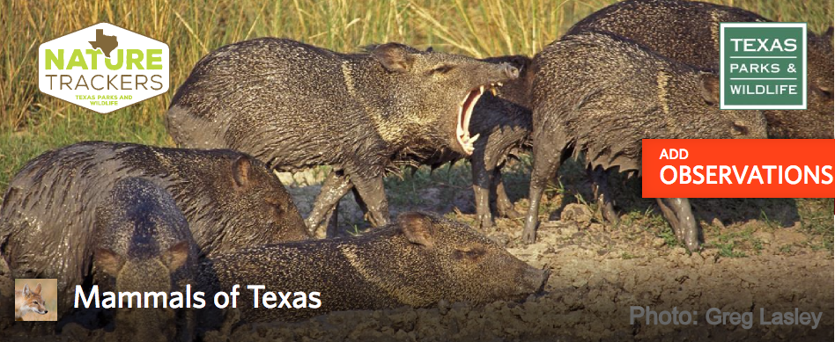
iNaturalist Groups
Mammals of Texas
How do the observations vary by county?
Does species richness vary by county?

Slide 11
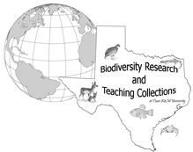
GBIF
What: Open-data biodiversity information repository
Who: Natural history collections, citizen science projects, etc.
Organizes specimen records from multiple sources using DarwinCore search terms

Slide 12
rgbif
Can be ornery at times, but works well
Main function to query GBIF is occ_search
Can choose terms to search with (scientificName, taxonKey, institutionCode, etc.)
Can grab only the fields you want
You can query only records with coordinate information
Can choose how many records you want

Slide 13
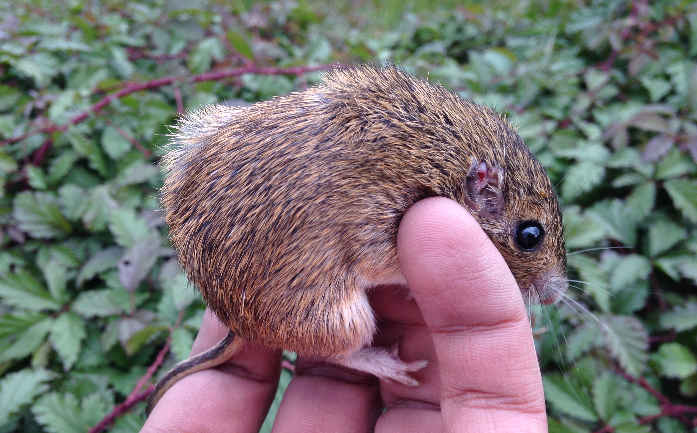
Introduction to the horrors/wonders of rgbif!
We are going to start in the best group: Heteromyids!

Slide 14
